Slide 1
Improving Optimal Mining Strategy using Deep Q-Learning
WIJEWARDHANA W.T.R.N.D.K
SC/2019/11116

Slide 2
Bitcoin Mining
The process of verifying Bitcoin transactions and recording them onto the public ledger.
Solved based on a difficult mathematical puzzle called Proof of Work (PoW).
The miner who first solves the puzzle gets rewarded.
𝓗(n, p, ｍ) ﹤ D
n : nonce
p : the hash of previous block
m : Merkle root of all included transactions
D : Target

Slide 3
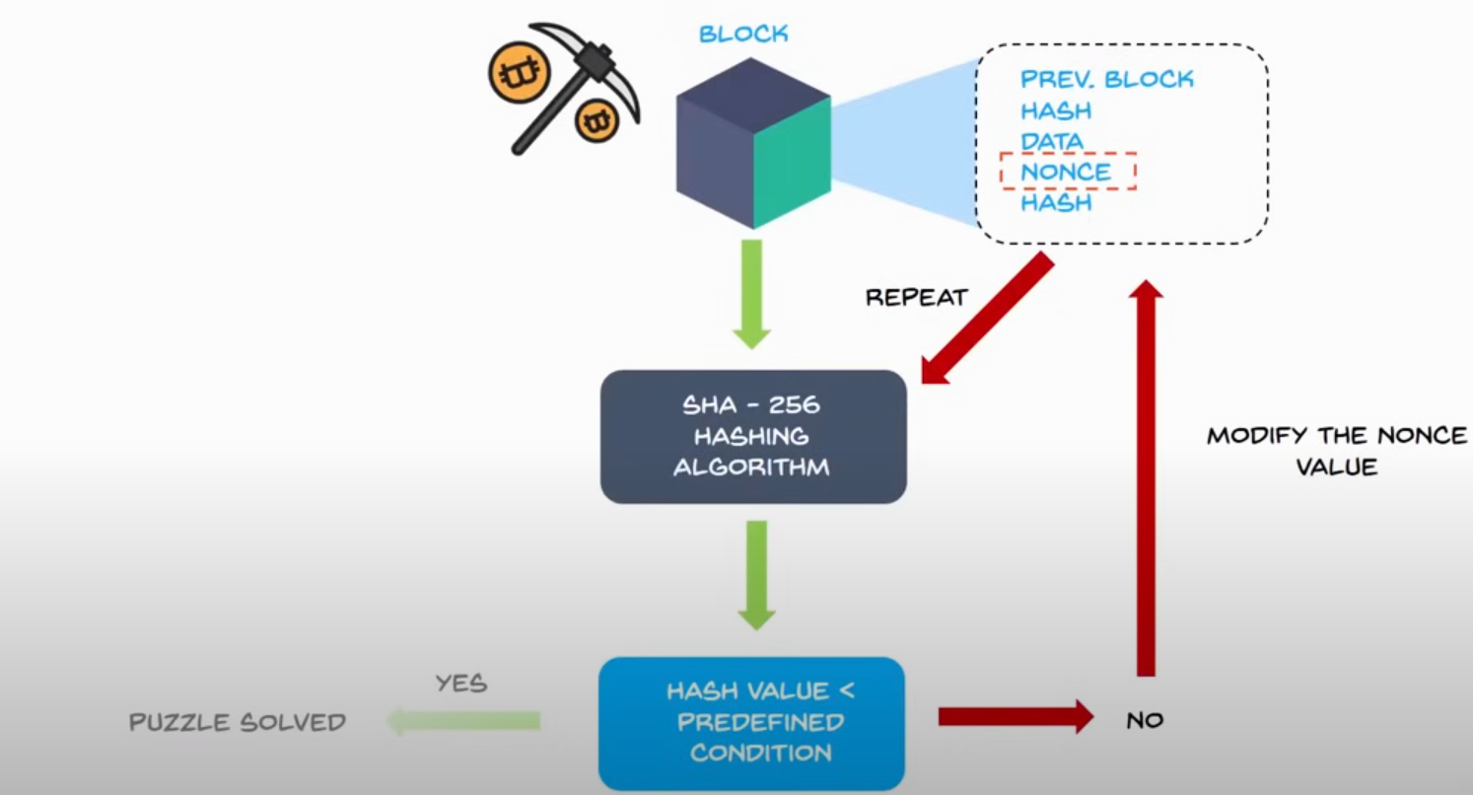
Proof of Work (PoW)

Slide 4
Mining Strategies
Different mining strategies
Honest mining
Immediately broadcasts as soon as the puzzle is solved
Selfish mining
Higher Rewards
Does not broadcast its mined block immediately
Say a miner mined two blocks before other miners do, it can broadcast its two blocks at the same time to override the block mined by others.
Goal : Maximize the reward

Slide 5
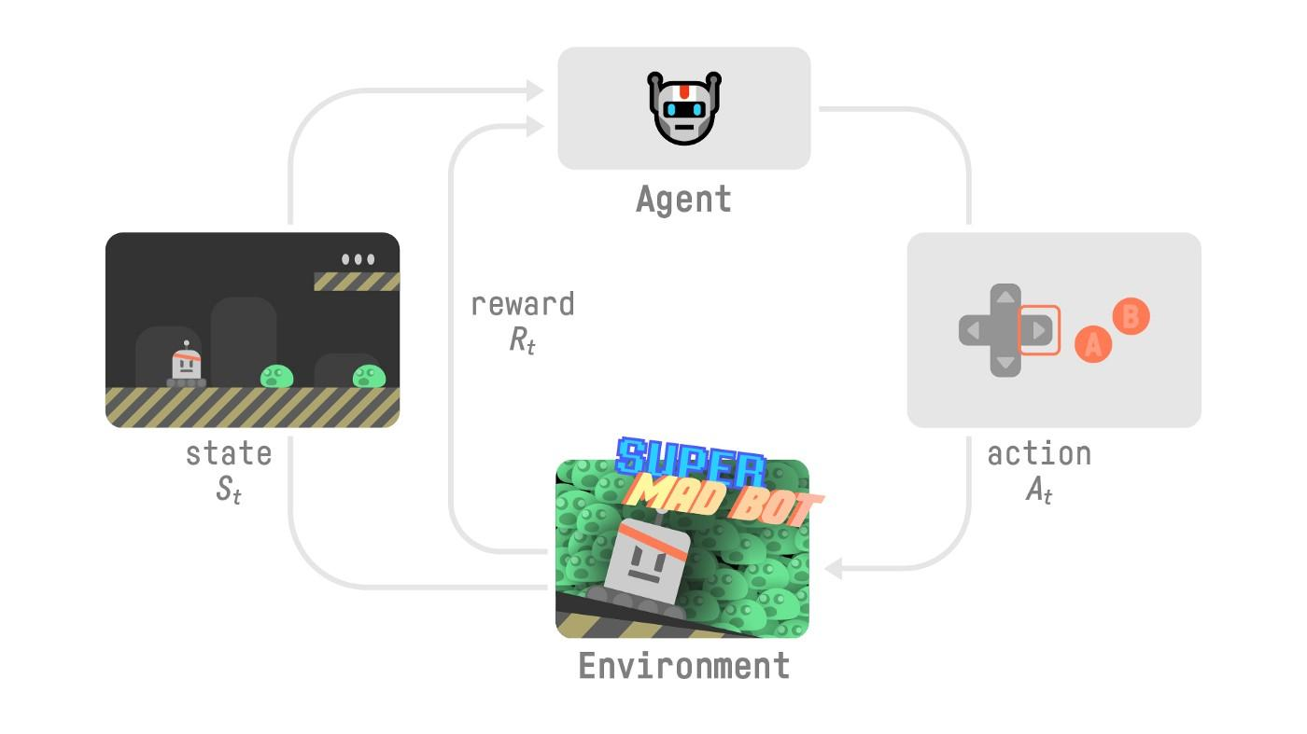
Reinforcement Learning
A subfield of Machine Learning (ML).
The agent learns how to behave in an environment by performing actions and seeing the results.
Goal : Maximize the expected return (expected cumulative reward).

Slide 6
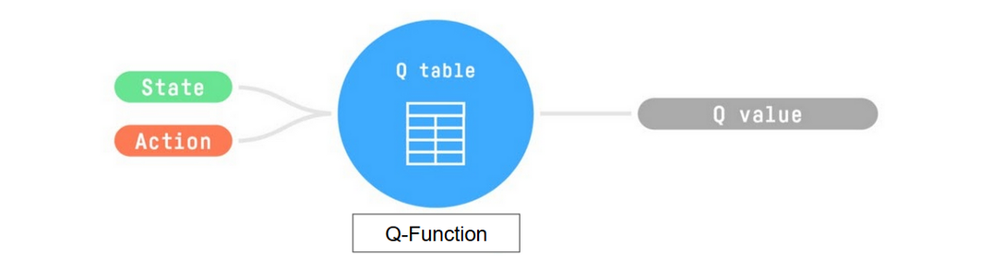
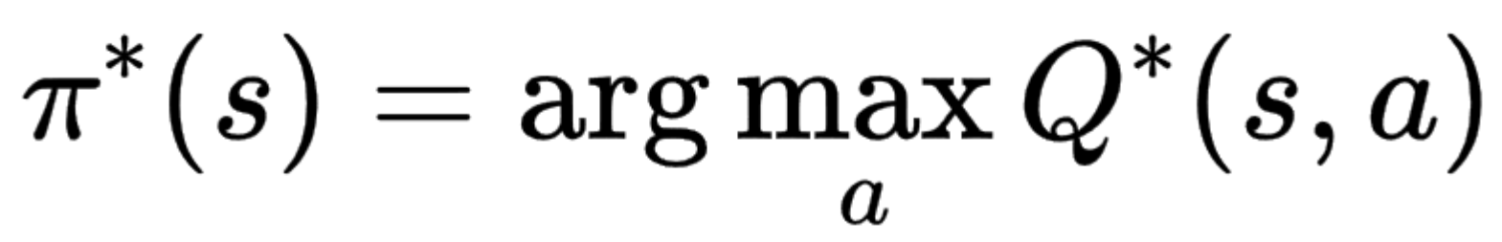
Simple Q-Learning
Q-Learning is an off-policy value-based method that uses a TD approach to train its action-value function
The Q comes from “the Quality” (the value) of that action at that state.
Internally uses a Q-Table where each cell is a state-action pair value.
Policy :

Slide 7
Drawback of Simple Q-Learning
The problem is that Q-Learning is a tabular method.
What if the states and actions spaces are large?
Not scalable
Consider an observation space with a shape of (210, 160, 3)*, containing values ranging from 0 to 255 so that gives us 256^{210×160×3}=256¹⁰⁰⁸⁰⁰

Slide 8
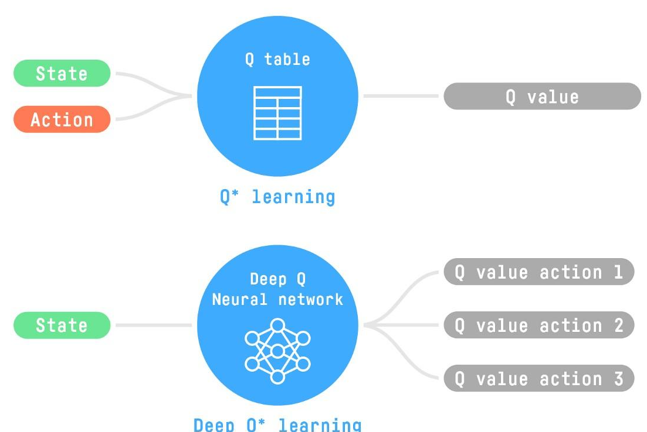
Deep Q-Networks
Uses a Deep neural network to approximate the different Q-values for each possible action at a state (value-function estimation).

Slide 9
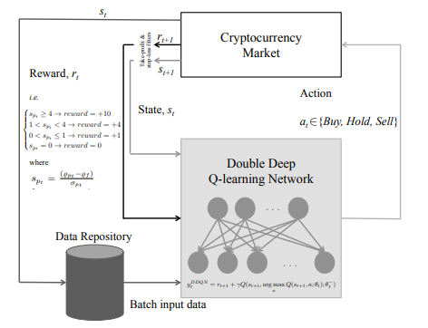

Related Applications of RL in Cryptocurrency
Automated Cryptocurrency Trading
Buying and selling Bitcoin via an exchange platform in short-term to make profit.
Lucarelli1 G. et al. [1] proposed a RL based approach using Double DQN (2 CNN layers with 120 neurons each) and DD-DQN (2 CNN layers with 120 neurons each followed by two FC layers) for automated trading.
Action space:

Slide 10
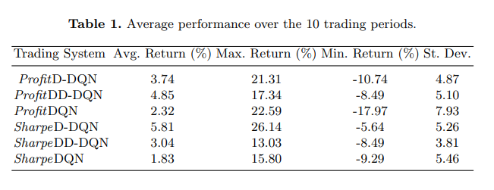
Automated Cryptocurrency Trading ctd…
Average performance over 10 trading periods

Slide 11
Back to bitcoin mining…
Selfish mining
Key terms:
Without loss of generality, Let’s say the whole network is divided into two entities honest network and adversary network (pool).
α: Ratio of a particular miner’s computing power over the computing powers of all miners.
γ: Communication capability– the fraction of the honest miners that will first receive the block from the adversary when the adversary and one honest miner release their blocks approximately at a same time.

Slide 12
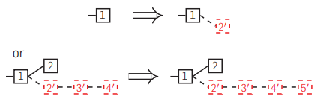

Selfish mining ctd…
Possible scenarios
Any state but two branches of length 1, pool finds a block.
Was two branches of length 1, pool finds a block.

Slide 13


Selfish mining ctd…
Possible scenarios
Was two branches of length 1, others find a block after pool head.
Was two branches of length 1, others find a block after others’ head

Slide 14
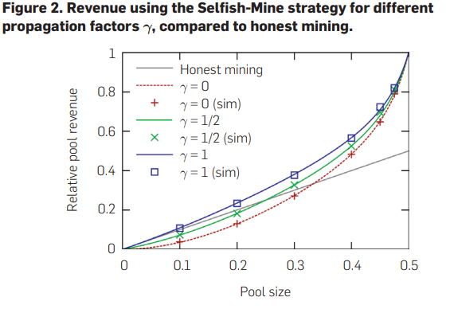
Selfish mining ctd…
Selfish mining is not always profitable.

Slide 15
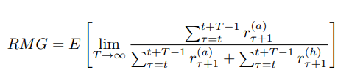
Optimal Mining Strategy
A. Sapirshtein et. al (2016) [2] formulated the mining problem as a general Markov Decision Process (MDP) with a large state-action space.
However, Objective Function [2] is not a linear function of scalar rewards.
[2] transformed the mining model to a family of MDPs with linear objectives.
Used a standard MDP solver to derive an optimal policy.

Slide 16
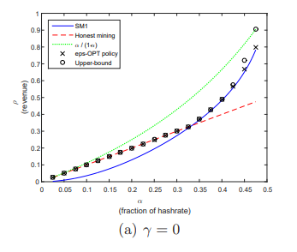
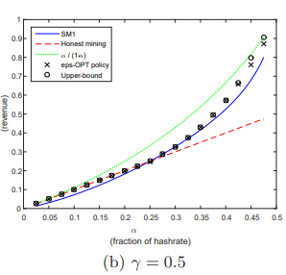
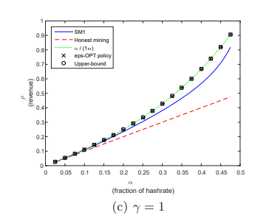
Optimal Mining Strategy ctd…
Performance
γ=0 γ=0.5 γ=1

Slide 17
Optimal Mining Strategy ctd…
However, the limitation of this approach is, it requires the knowledge of parameters such as pool’s computing power (α) and communication capability (γ).
They are not easy to obtain in real blockchain networks
Mitigating this problem, Wang T. et. al. [3] proposed a model-free RL based approach based on Q-Learning for achieving optimal mining strategy.

Slide 18
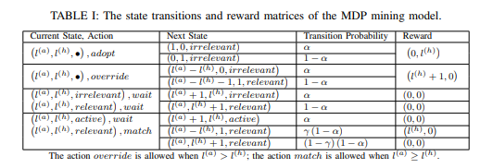
When Blockchain Meets AI
As the objective function is nonlinear [3] incorporated a slightly refined version of classic Q-Learning algorithm called multidimensional Q-Learning.
[3] incorporated the mining MDP model proposed by [2].

Slide 19
Limitations and improvements of the current model
[4] More complete MDP model was proposed for blockchain networks– captured detailed blockchain features, such as stale block rate, double spending attack, and eclipsed attack. More challenging for RL mining to learn an optimal strategy because of large action-space.
DQN or Double DQN can be utilized to withstand this large action-space

Slide 20
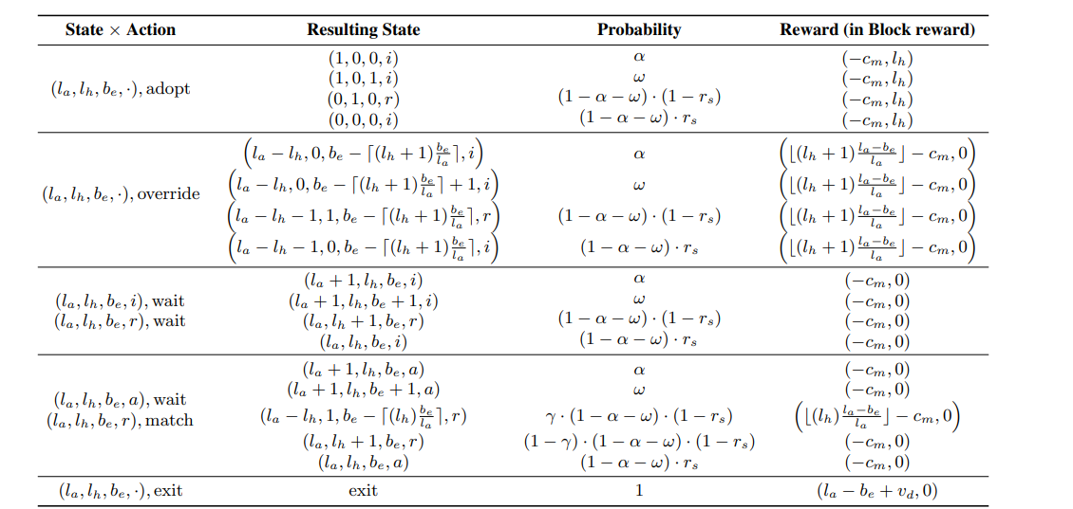
New MDP Mining Model
State-Action Space

Slide 21
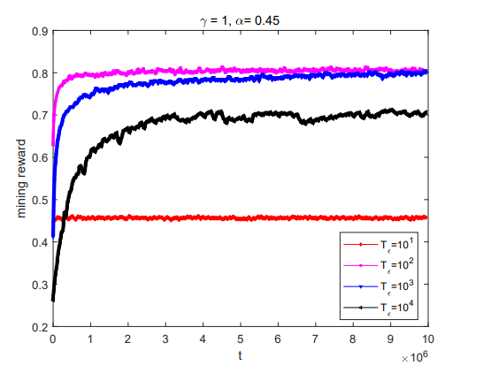
Limitations of the current model ctd…
Cost of lagged time in convergence– Needs faster convergence (Economical)
Deep RL [5] that incorporates deep neural networks into RL can potentially speed up the convergence rate.

Slide 22
Objectives of our Research
Evolving the existing Reinforcement Learning model to the newer MDP mining model proposed by [4].
Utilizing Deep Reinforcement Learning for better convergence of the algorithm.

Slide 23
References
[1] Lucarelli, G., Borrotti, M. (2019). A Deep Reinforcement Learning Approach for Automated Cryptocurrency Trading. In: MacIntyre, J., Maglogiannis, I., Iliadis, L., Pimenidis, E. (eds) Artificial Intelligence Applications and Innovations. AIAI 2019. IFIP Advances in Information and Communication Technology, vol 559. Springer, Cham. https://doi.org/10.1007/978-3-030-19823-7_20
[2] A. Sapirshtein, Y. Sompolinsky, and A. Zohar, “Optimal selfish mining strategies in bitcoin,” in International Conference on Financial Cryptography and Data Security. Springer, 2016, pp. 515–532.
[3] arXiv:1911.12942 [cs.CR] https://doi.org/10.48550/arXiv.1911.12942
[4] A. Gervais, G. O. Karame, K. Wust, V. Glykantzis, H. Ritzdorf, ¨ and S. Capkun, “On the security and performance of proof of work blockchains,” in Proceedings of the 2016 ACM SIGSAC conference on computer and communications security. ACM, 2016, pp. 3–16.
[5] V. Mnih, K. Kavukcuoglu, D. Silver, A. A. Rusu, J. Veness, M. G. Bellemare, A. Graves, M. Riedmiller, A. K. Fidjeland, G. Ostrovski et al., “Human-level control through deep reinforcement learning,” Nature, vol. 518, no. 7540, p. 529, 2015

